Slide 1
Global Model Evaluation
Local Analysis
Model Architecture and General Performance

Slide 2
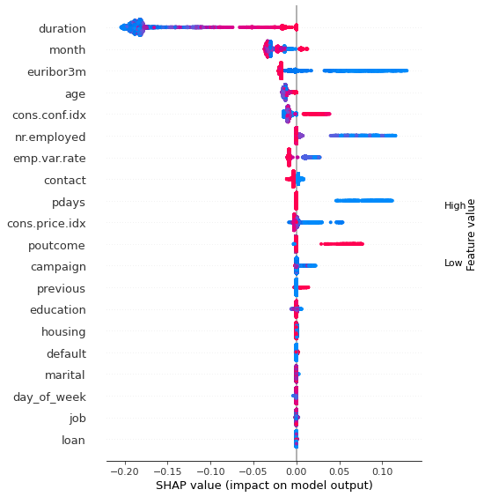
General Model Evaluation
Globally seen the most important feature is the duration of the call
The shorter a call was the more negative impact it has on the model. In long calls the duration has only little imapct on the model.
Nr. employed is also important with low numbers having a strong positive impact.
The education of the customer is rather unimportant and the impact of low scores on the model is inconclusive

Slide 3
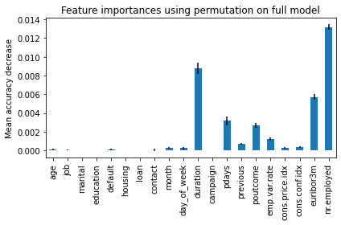
Global Feature Importance using Permutations
To check the SHAP values we can look at the wheights in the classifier and secondly use permutations to get the importances.
Since we see a similar order of the importances we can use the SHAP values.

Slide 4
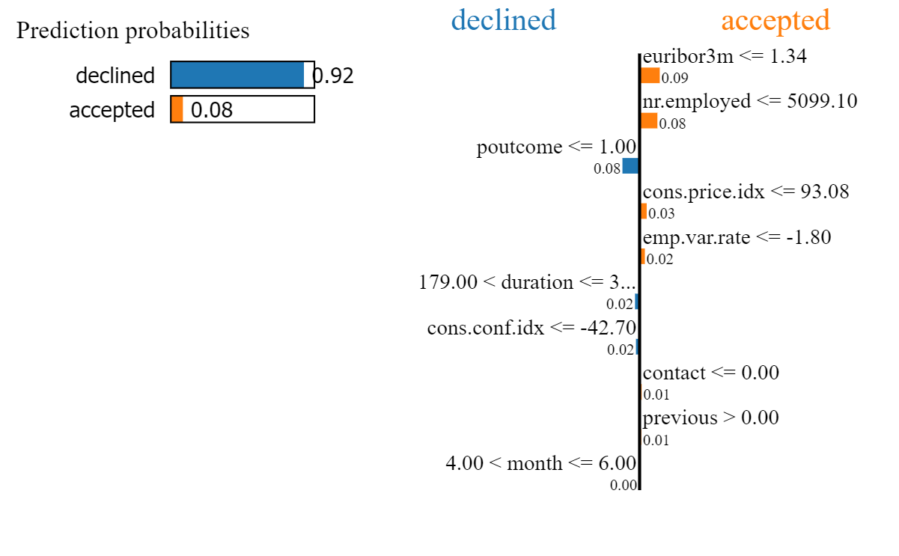
Local Analysis
We now predict a single customer. Here we can first see how secure the prediction was.
Second, we can see which attributes influenced the decision. We see the attribute of the number of employees is pushing in the wrong direction. As seen before a high value in this attribute will not have great affect on the model. If it was not the case this prediction would have been wrong.
For this customer we can see that the decision was taken mostly on the attribute poutcome which is the outcome of a previous marketing campaign. Here preveouis campaigns have failed. This is wheighted very high.
From this we can also conclude it does not make much sense retry previously failed attempts.

Slide 5
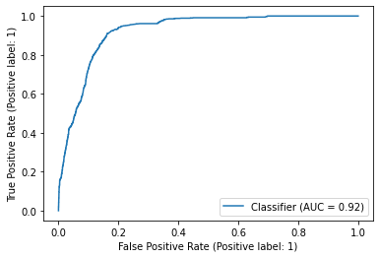
Model Architecture and General Performance
Random-Forest-Classifier with maximal depth of three to counter overfitting.
Accuracy: 89.74%
Since the focus should not lie on the model but on the evalution I was pleased with this first try model and apart from precision/recall tuning I did not try to further improve it.
Jupyter Notebook:

